Slide 1
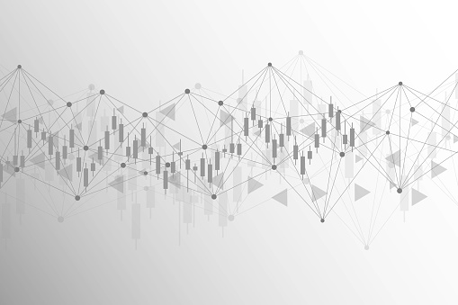

Forex Trend Analysis
by Nikolett Szabo November 2020
Notes:
The foreign exchange market, often referred to as the Forex, is the global marketplace for the trading of one nation's currency for another.
There are 180 different kinds of official currencies in the world. However, most international forex trades and payments are made using the U.S. dollar, British pound, Japanese yen, and the euro.
So today I will follow this trend and not expand to that wide range.

Slide 2
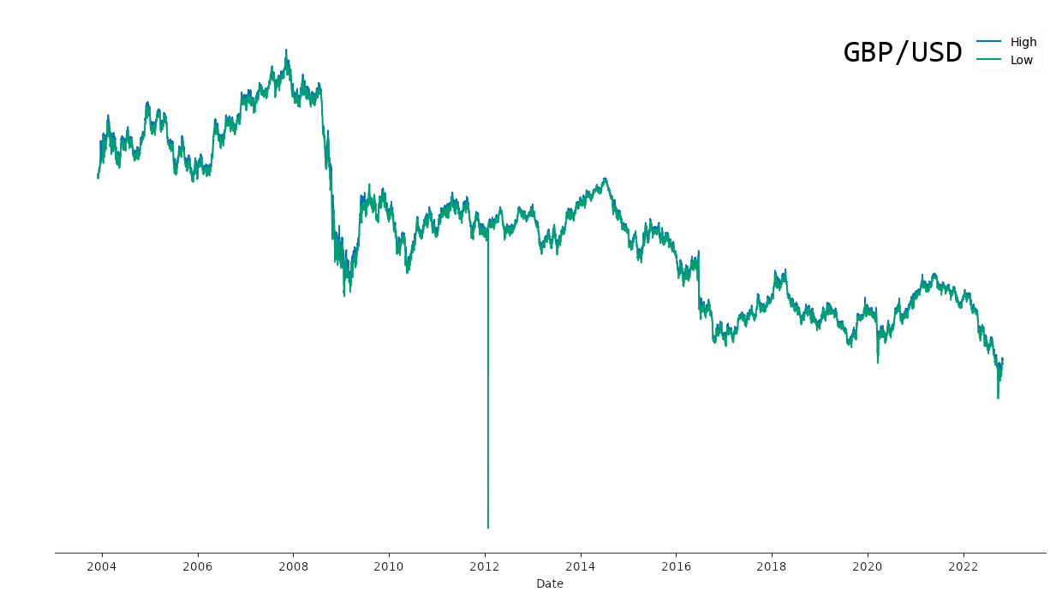
Notes:
In order to analyse forex market data, I had to carry out time series analysis.
Time series analysis is a specific way of analysing a sequence of data points collected over an interval of time. In time series analysis, data points are recorded at consistent intervals over a set period of time, rather than just recording the data points intermittently or randomly, hence my continuous line chart.

Slide 3
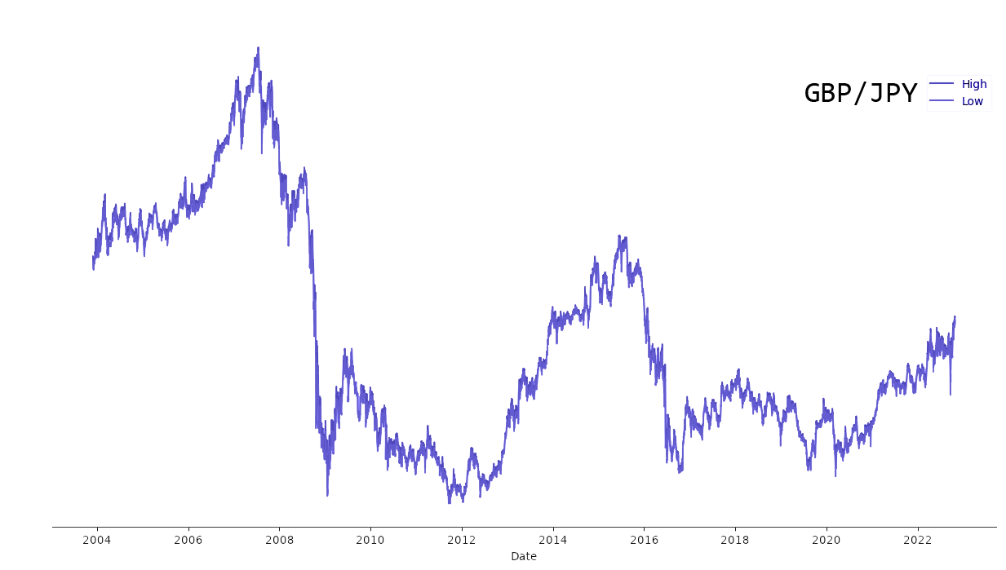
Notes:
I have not included the exact exchange rate on the y axis but rather focused on the trend the forex market shows us.
By comparing the
- pound to dollars then
- pound to yen we can see a huge fall in the British currency.
The global financial crisis caused a substantial fall in average UK house prices, which dropped by more than 15% in February, 2009.
(hit for arrow)
Between October 2008 and March 2009, the Bank of England base rate was lowered 7 times, reducing the cost of borrowing from 5.0% to 0.5%

Slide 4
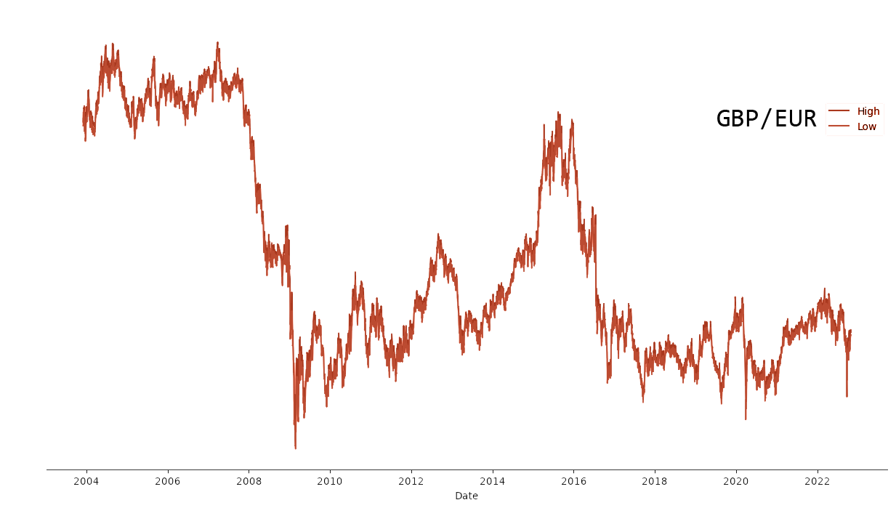
Notes:
And just by expandig the comparison to the pound to euro forex pair, it is safe to say that time series analyis provides us an overwhelming amount of data.
In my project I went deeper and analysed two major economic shocks from the past 2 decades.

Slide 5
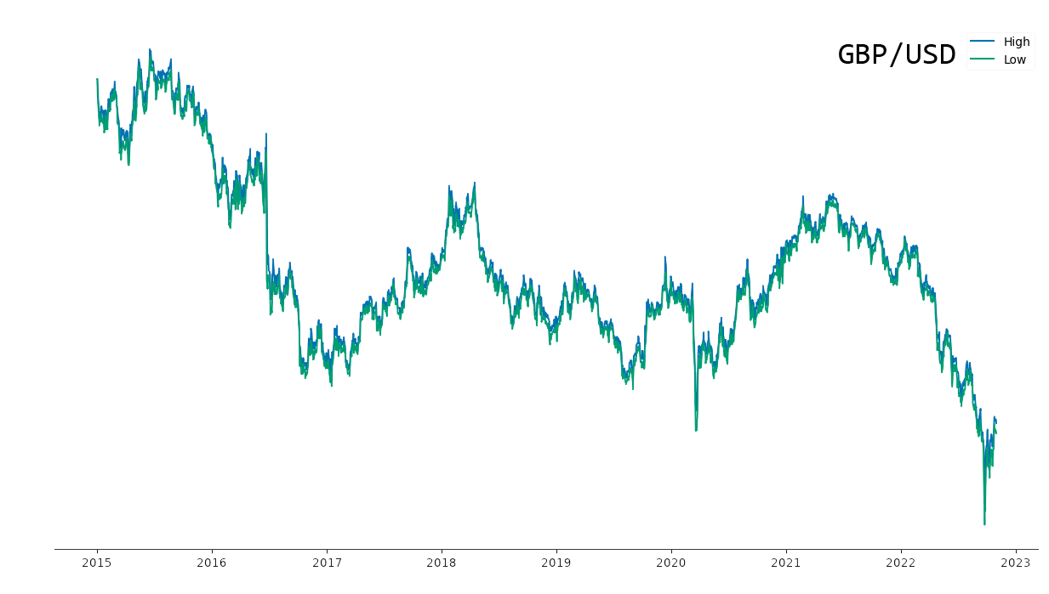
Notes:
It has been just over five years since the UK voted to leave the Europen Union and the world has changed dramatically since June 2016
However, the fall in the value of sterling happened before Brexit had actually taken place. In contrast, the exchange rate movements were relatively minor when the UK actually left the European Union and the transition period ending at the end of 2020.

Slide 6
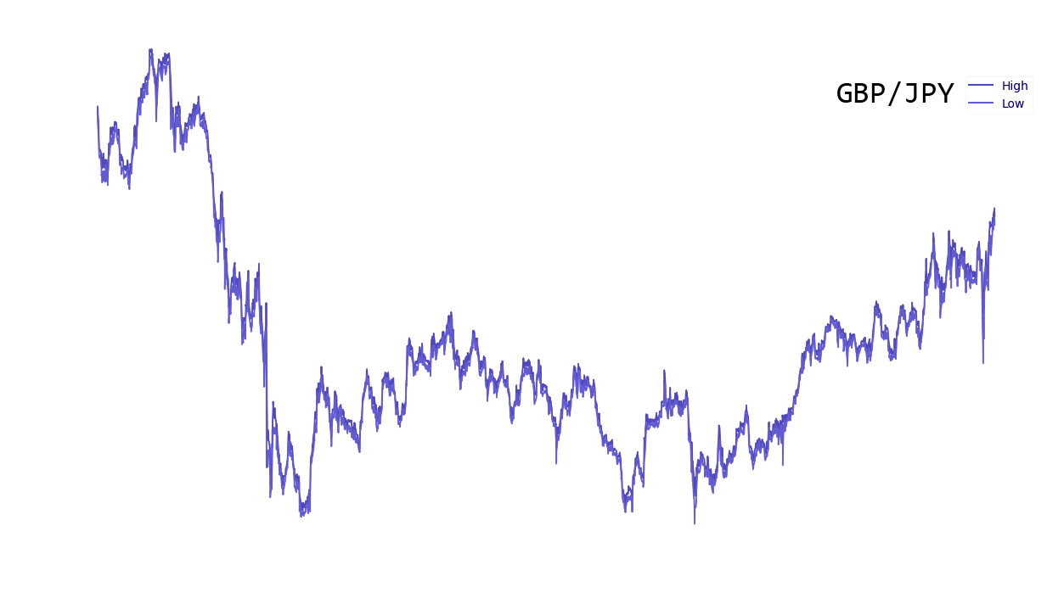
Notes:
The global pandemic has not helped UK businesses either since the end of the transition period.
The increase in the uncertainly and persistent political instability resulted in financial institutions looking to sell off the pound, and as a result the value of the pound became weaker.

Slide 7
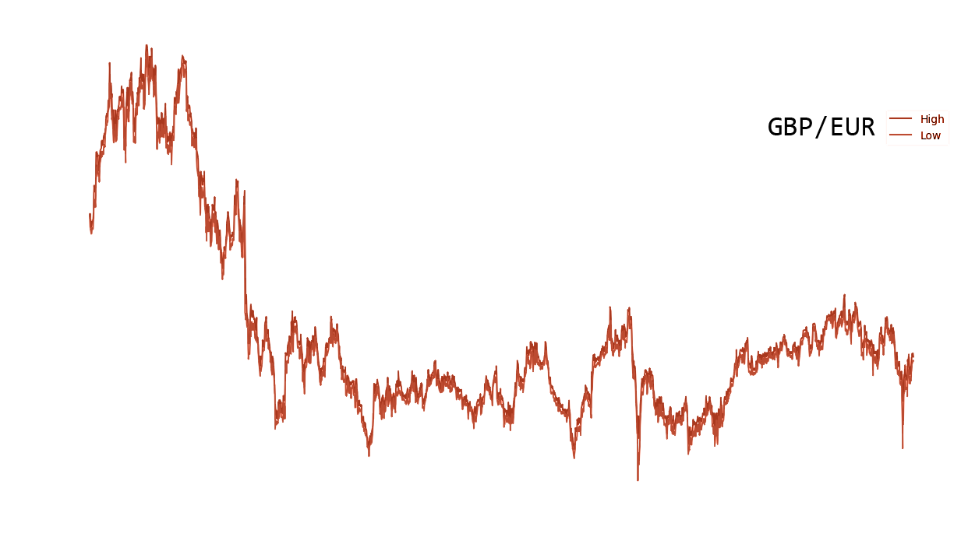
Notes:
At the start of 2021, sterling was 15% weaker relative to the euro than it was on the eve on the referendum of the vote for the UK to leave. (23 June, 2016)
There are multiple reasons as to why currency moves, but over the last five years one of the main factors of the fluctuation of currency rates is because of trade frictions between the UK and the EU.
One immediate consequence of a fall in sterling is that foreign goods, services and assets become more expensive for UK residents. This results in higher levels of inflation and a higher cost of living.

Slide 8
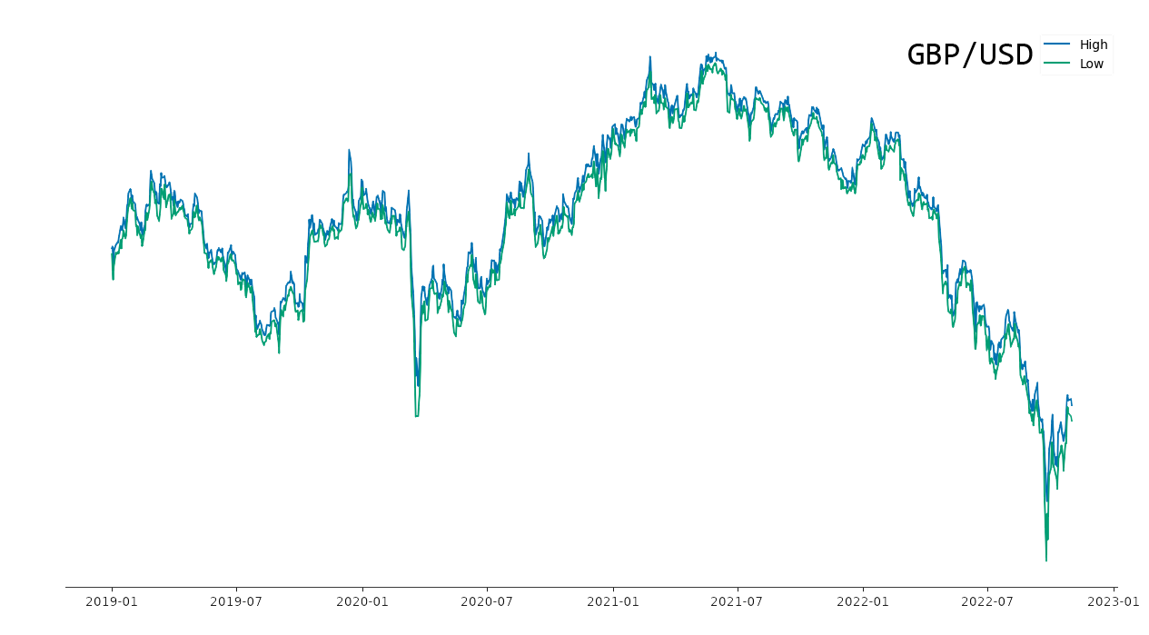
Notes:
The 2nd shock - COVID pandemic.
The global pandemic definitely has not helped UK businesses since the end of the transition period.
(hit for arrow)
Between April - June 2020, during the first national lockdown, the pound has fallen to its lowest level against the dollar since 19 85, as the spread of the coronavirus pandemic spooked investors.

Slide 9
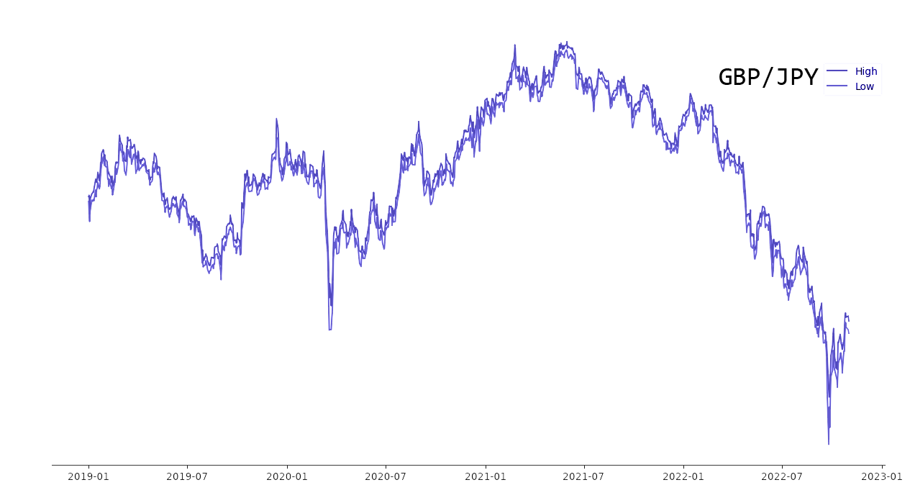
Notes:
The GDP fell by a record 19.4% before rebounding 17.6% as the country reopened over the summer.

Slide 10
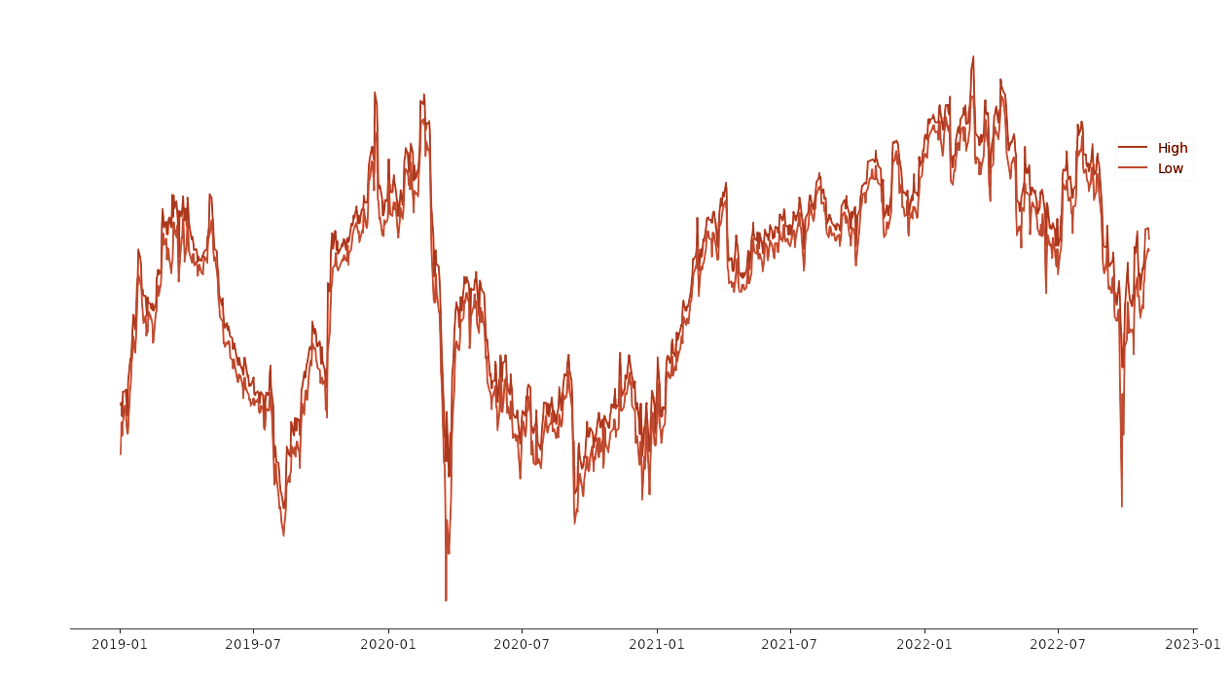
Notes:
The increase in the uncertainly and persistent political instability resulted in financial institutions looking to sell off the pound, and as a result the value of the pound became weaker.

Slide 11
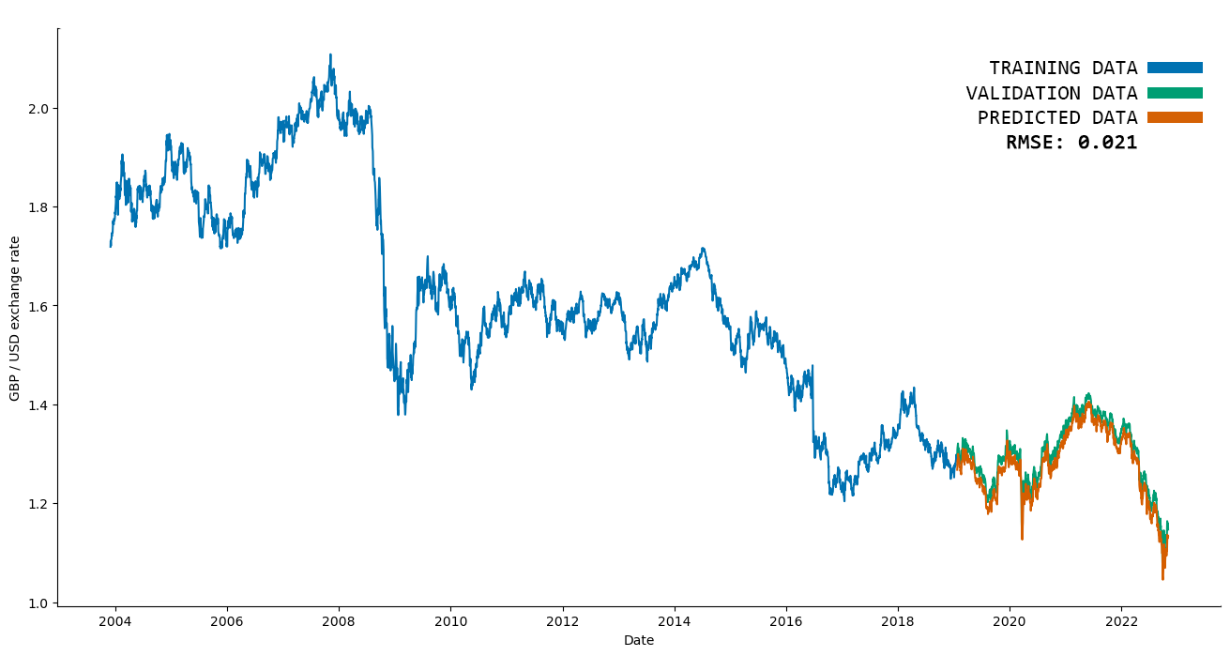
Notes:
Some insight to my work from this week:
I tried to predict the exchange rate post economic shock, by training the chosen time series analyis model on the pre-shock data including covid as well.
As you can, the green and orange lines which represnet the validation data and the predicted data, are fairly close to each other, showing that my model seems to work quite well.
And while we could think that with a rmse rate of 0.021 my prediction could be put in use, sadly that is not the case. The forex maket is not that volatile as the stock market, hence investors have to invest hugh amount of money to make a profit, in which case my model would not be accuate enough just YET to rely on my prediction.
moving forward I would try out other metrics in my model and I would also train - test my predictions on other currencies as well, bur a one week project, I used LSMT and ARIMA only.

Slide 12
Conclusion
Notes:
The Pound being the 4th most-traded currency on the forex market – accounting for almost 13% of daily turnover, it seems to bounce back over the time, keeping its dominance in the world financial sector.
Despite the bumps I have talked about, overall we can agree that investing in pound seems to pay off in the long run.

Slide 13
The End

